Slide 2
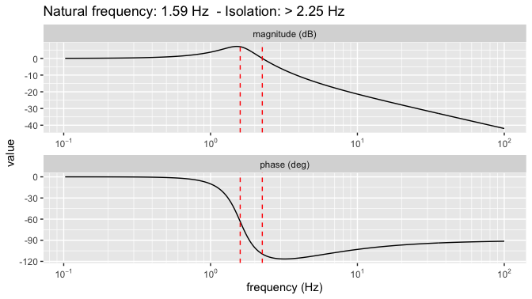
0.085
-103°
10 Hz

